Slide 1
NAIST 4102: NLP 1
Introduction
Taro Watanabe
taro@is.naist.jp
NAIST NLP

Slide 2
What is NLP?
Natural Language Processing (NLP) = Processing human language by computers.
Processing = {analysis, generation, acquisition}

Slide 3
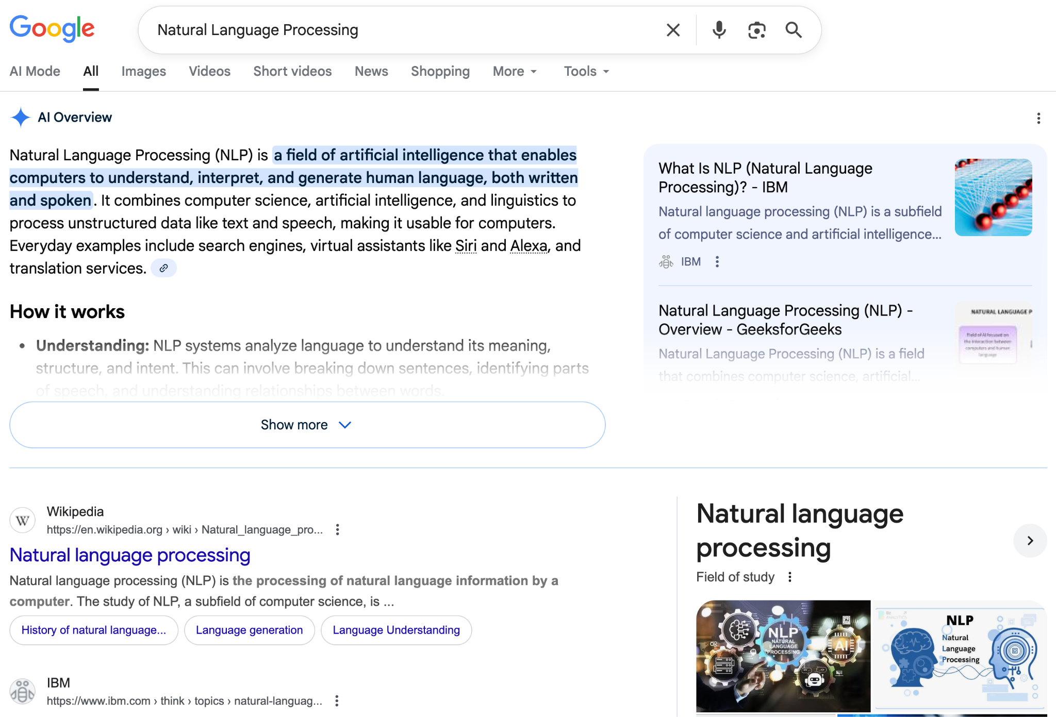
Why NLP? Google, Facebook, etc.
Search
Summarization
Knowledge extraction
Question answering
Image extraction
https://google.com

Slide 4
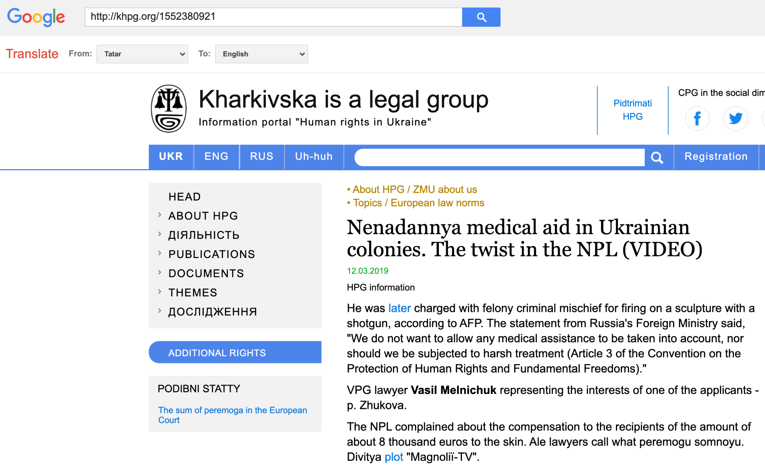
Why NLP? Machine Translation by Google, DeepL etc.
https://translate.google.com

Slide 5
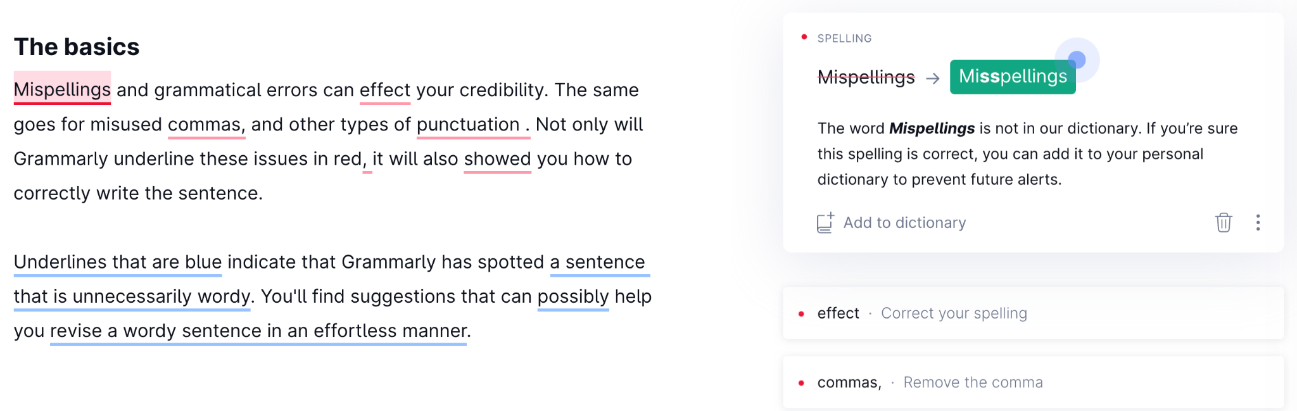
Why NLP? Grammatical error correction by Grammarly etc.
https://grammarly.com

Slide 6
How to represent linguistic information?
Language analysis, generation and acquisition by computers.
Analysis: Given a language input, outputs some representation for end tasks, e.g., QA.
Generation: Given some representation, outputs language.
Acquisition: From language data or knowledge base, induce representation.
What is linguistic representation?

Slide 7
Linguistic Representation “Pyramid”
Discourse
Pragmatics
Semantics
Syntax
Morphology and Lexemes
Words

Slide 8
Words
“The San Francisco-based restaurant,“ they said, “doesn’t charge $10”.
A sentence is split into words usually by spaces: tokenization
Punctuations, e.g, “.”, “?” are also separated.
Special handling for languages without explicit barriers, e.g., Japanese.
“␣The␣San␣Francisco-based␣restaurant␣,␣“␣they␣said␣,␣ “␣does␣n’t␣charge␣$10␣”␣.
An example from Chap. 2 of SLP

Slide 9
Morphology and Lexemes
Janet will back the bill
Janet will back the bill
Analyze meaningful components of words.
Complexity differs across languages:
Analytic: English
Isolating: Chinese
Synthetic: Turkish
Usually performs Part of Speech tagging.
NNP
MD
VB
DT
NN
An example from Chap. 8 of SLP
姚明进入总决赛
姚明␣进入␣总决赛
NR
VV
NN
An example from Chap. 2 of SLP

Slide 10
Syntax
✔
Alice will go to a bookstore.
✔
Alice went to the bookstore.
the to Alice bookstore went.
Analyze compositional structure of symbols by pasing.
Related linguistic theories, e.g., well-formedness.
Ambiguities cause combinatorial explosion.
John saw the woman with the telescope
bought at a store

Slide 11
Semantics
The dog wants to eat the bone
The dog wants to eat the bone
(w / want-01
:ARG0 (d / dog)
:ARG1 (e / eat-01
:ARG0 d
:ARG1 (b / bone)))
Mapping into object-predicate relations.
Many frameworks for representation, e.g., AMR, HPSG.
Related to KG, a database of entities and relations.
w/want-01
ARG0
ARG1
d/dog
ARG0
e/eat-01
ARG1
b/bone
An example from AMR tutorial.

Slide 12
Pragmatics and Discourse
John wanted to buy a piano for his living room.
Jenny also wanted to buy a piano.
He went to the piano store.
It was nearby.
The living room was on the second floor.
She didn’t find anything she liked.
The piano he bought was hard to get up to that floor.
John wanted to buy a piano for his living room.
Jenny also wanted to buy a piano.
He went to the piano store.
It was nearby.
The living room was on the second floor.
She didn’t find anything she liked.
The piano he bought was hard to get up to that floor.
Pragmatics: non-sentence-local meaning.
Discourse: structures in a sequence of sentences.
Documents, dialogues, etc.
An example from Chap. 22 of SLP

Slide 13
What are NLP applications?
Sentiment Analysis
Information Extraction
Machine Translation
Summarization
Image Captioning
Dialogue (Conversation agent)
Question Answering

Slide 14
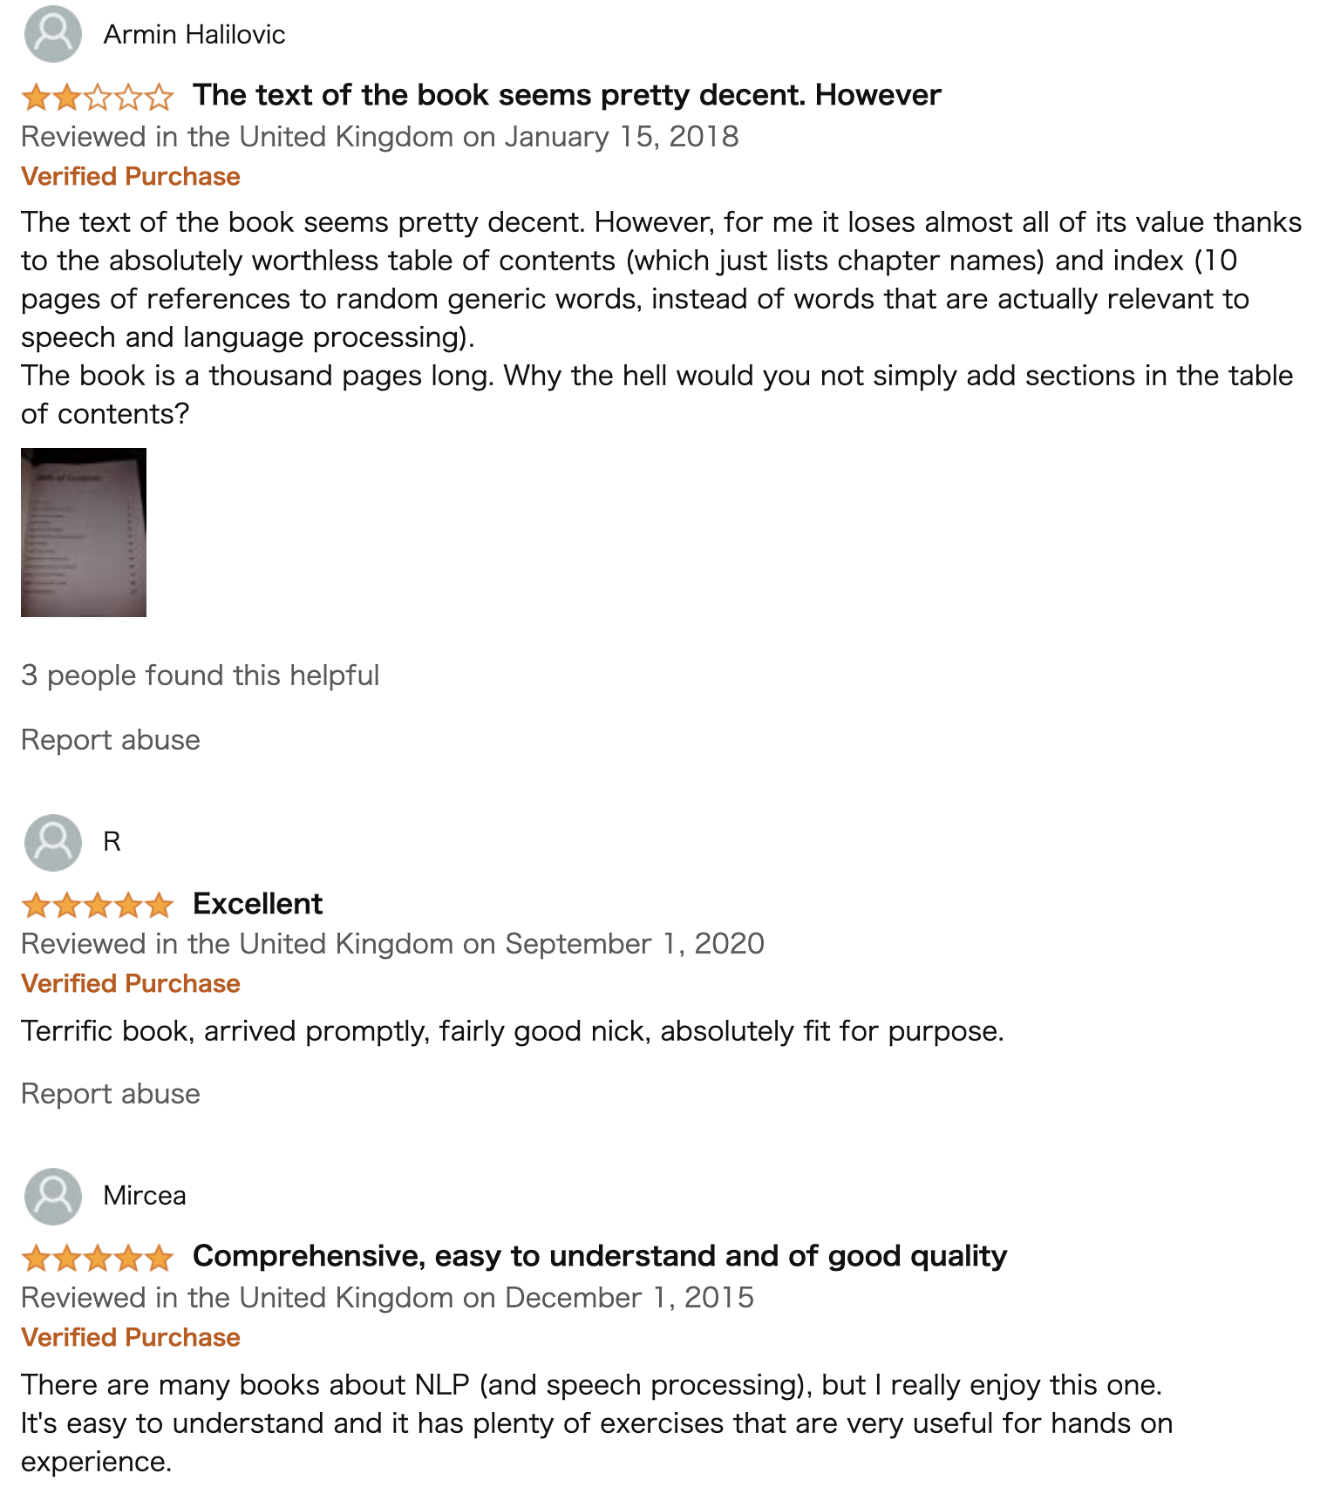
Sentiment Analysis
Categorize whether the entire text is positive or negative.
Many variations:
5-star ranking.
Summary of opinion.
An example from Amazon.

Slide 15
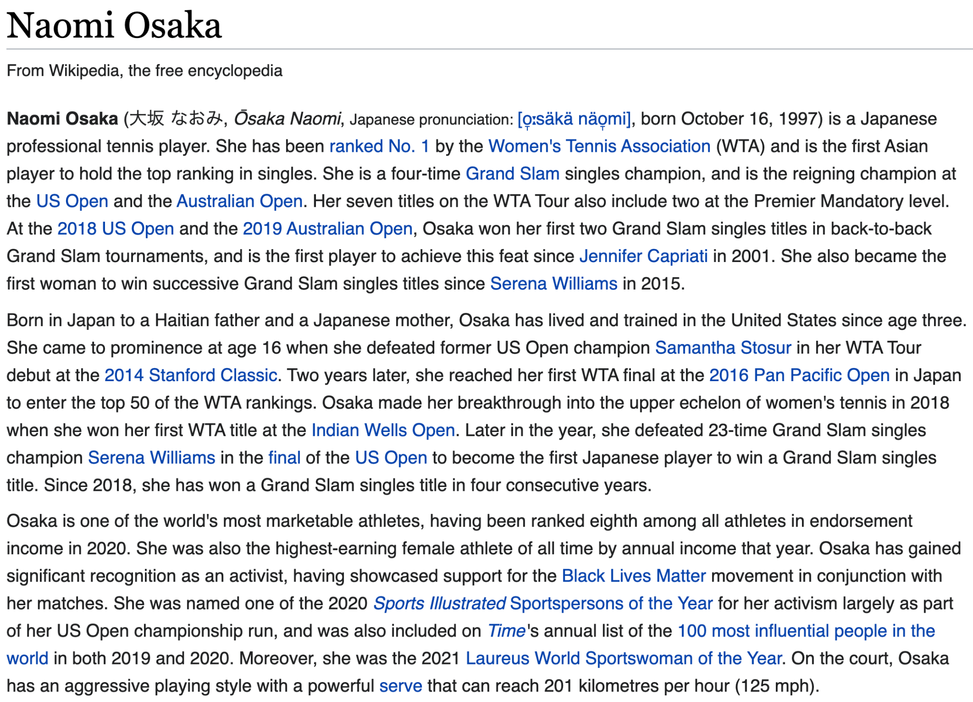
Information Extraction
Identify facts from documents or semi-structured text and transfer them as structures.
Usually structured as triples, e.g., (subject, predicate, object) = (head, relation tail).
(Naomi Osaka, born, October 16, 1997)
Wikipedia

Slide 16
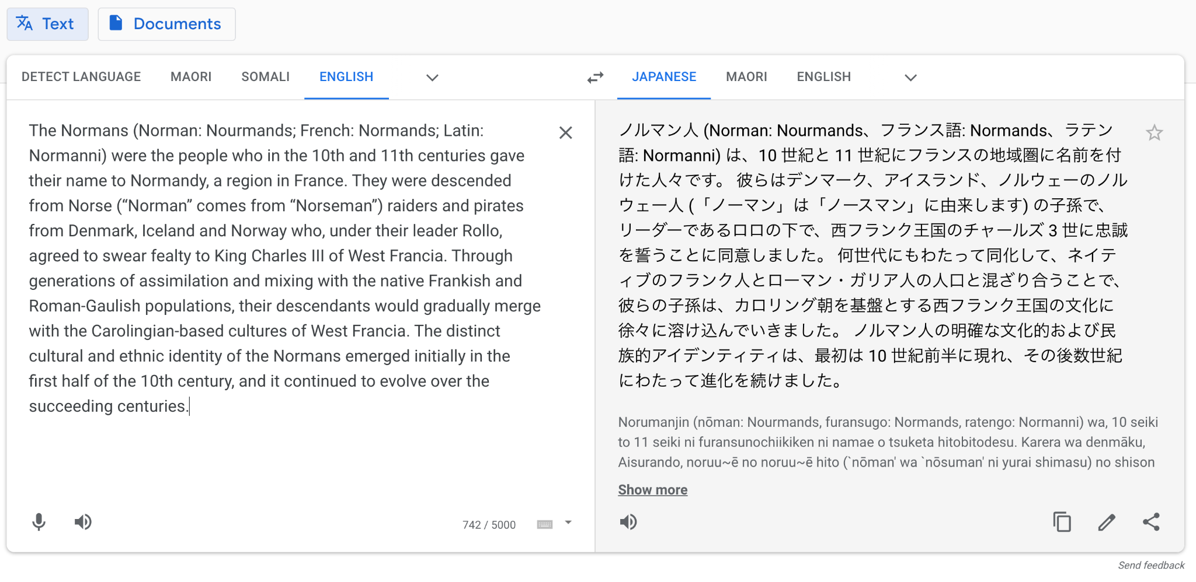
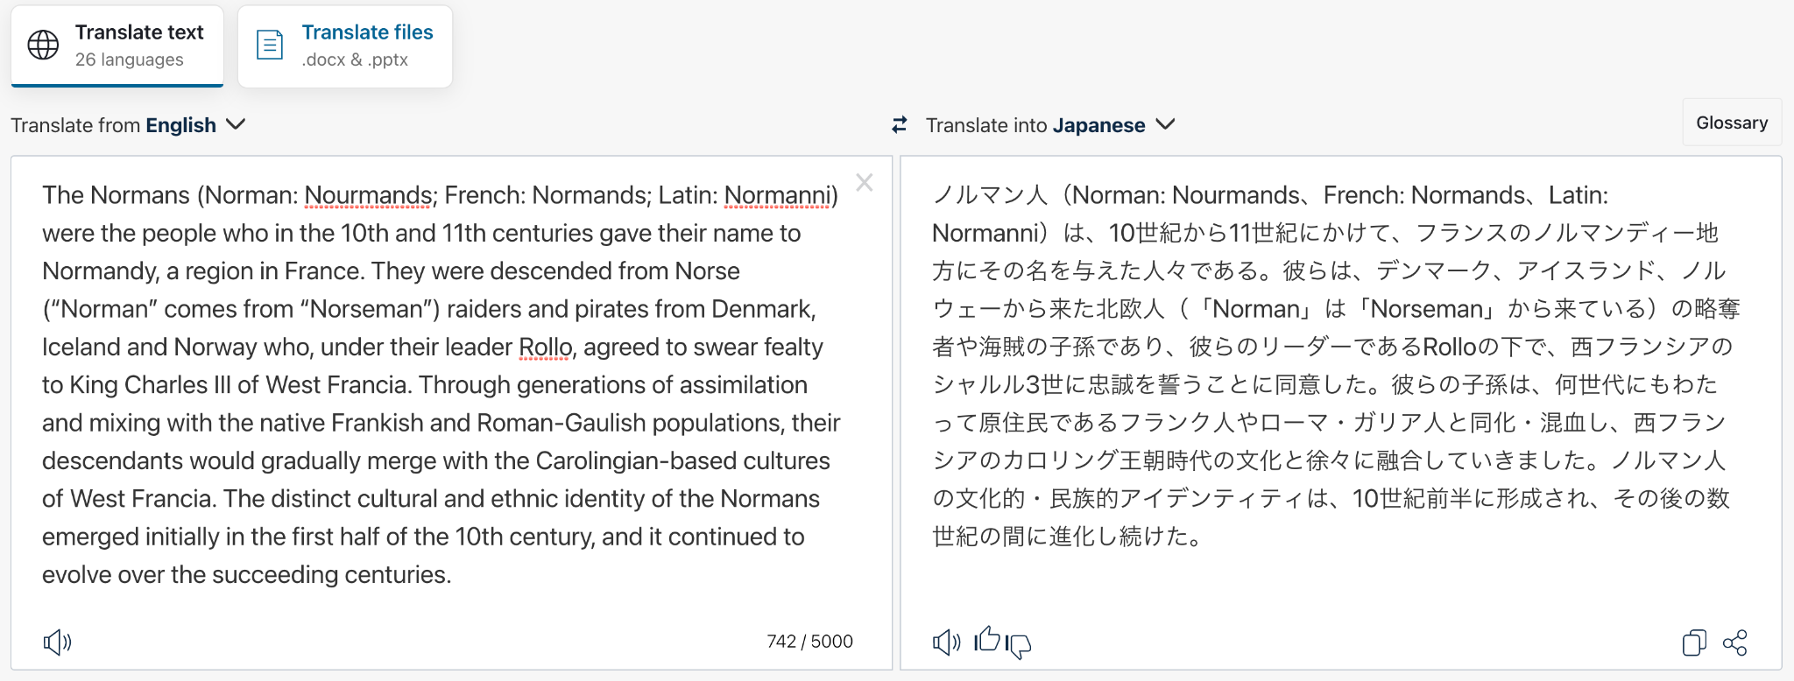
Machine Translation
Sentence-to-sentence or document-to-document transfer from one language to another.
An instance of conditional language model, i.e., sequence-to-sequence model.
(Google Translate)
(DeepL)

Slide 17
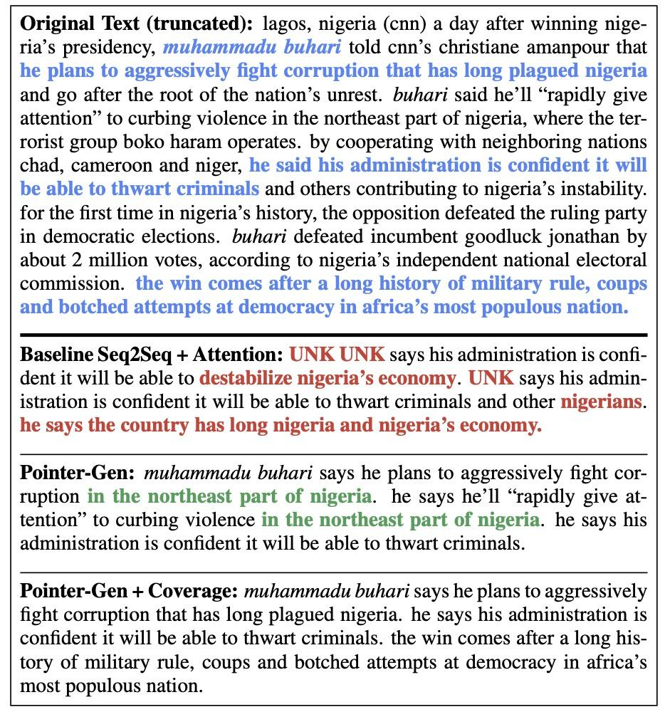
Summarization
Document-to-sentence transfer.
Either extractive or abstractive summarization.
An instance of conditional language model over long document inputs.
(See et al., 2017)

Slide 18
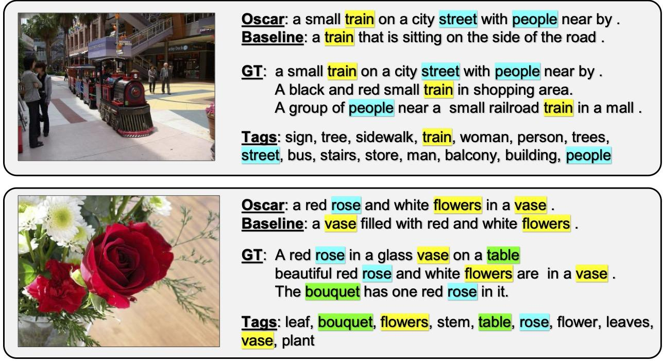
Image Captioning
Image to text generation.
An instance of conditional language model with image representation as an input.
Diverse explanations for each image.
(Li et al., 2020)

Slide 19
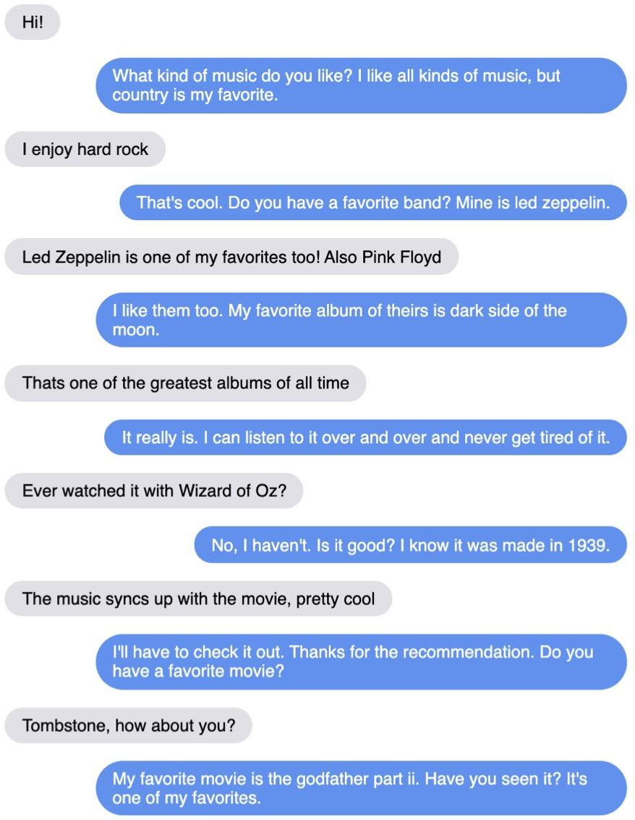
Dialogue
Text history-to-text generation with interleaved user/agent.
An instance of conditional language model.
(Roller, 2021)

Slide 20
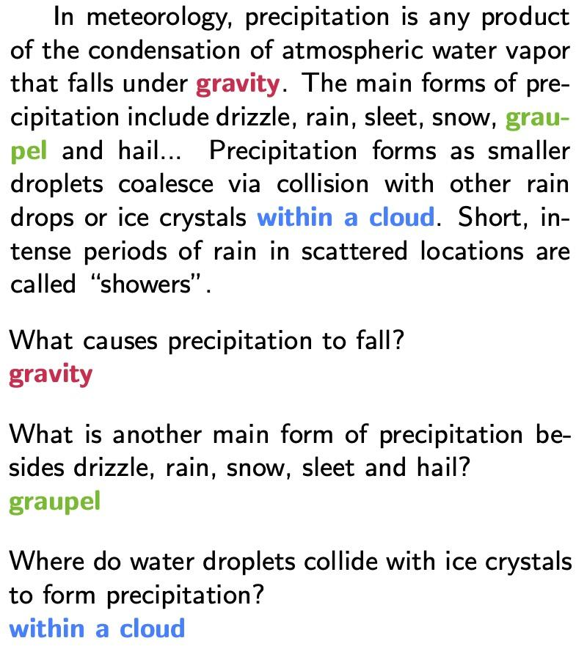
Question Answering
Given a question, identify the “span” of a document as an answer.
Large pre-trained language model to represent a document.
An instance of query-span model.
(Rajpurkar, 2016)

Slide 21
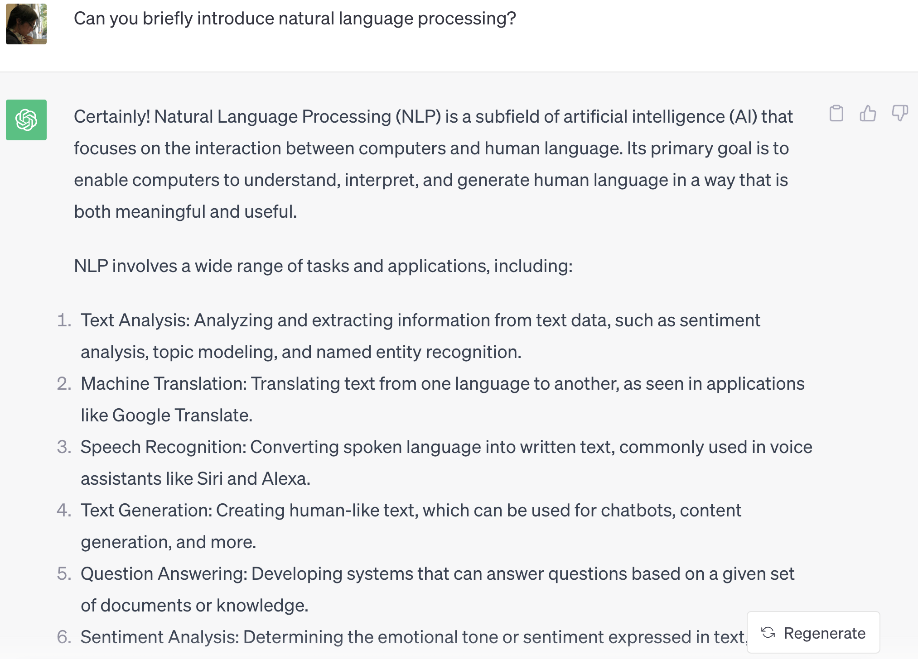
Chat by LMs
Modeling language from many texts can solve many problems.
Generalization into many problems through prompting.
https://chat.openai.com/

Slide 22
Why is NLP Hard?
Ambiguity
Sparsity
Variation
Knowledge

Slide 23
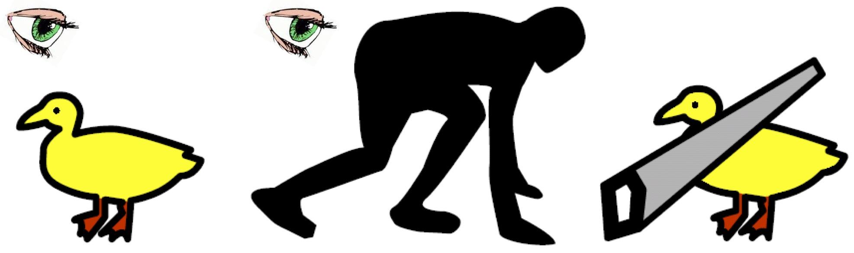
Ambiguity
I saw her duck.
Ambiguity in multiple levels, e.g., word sense, part of speech, syntax.
An example from a slide by Liang Huang

Slide 24
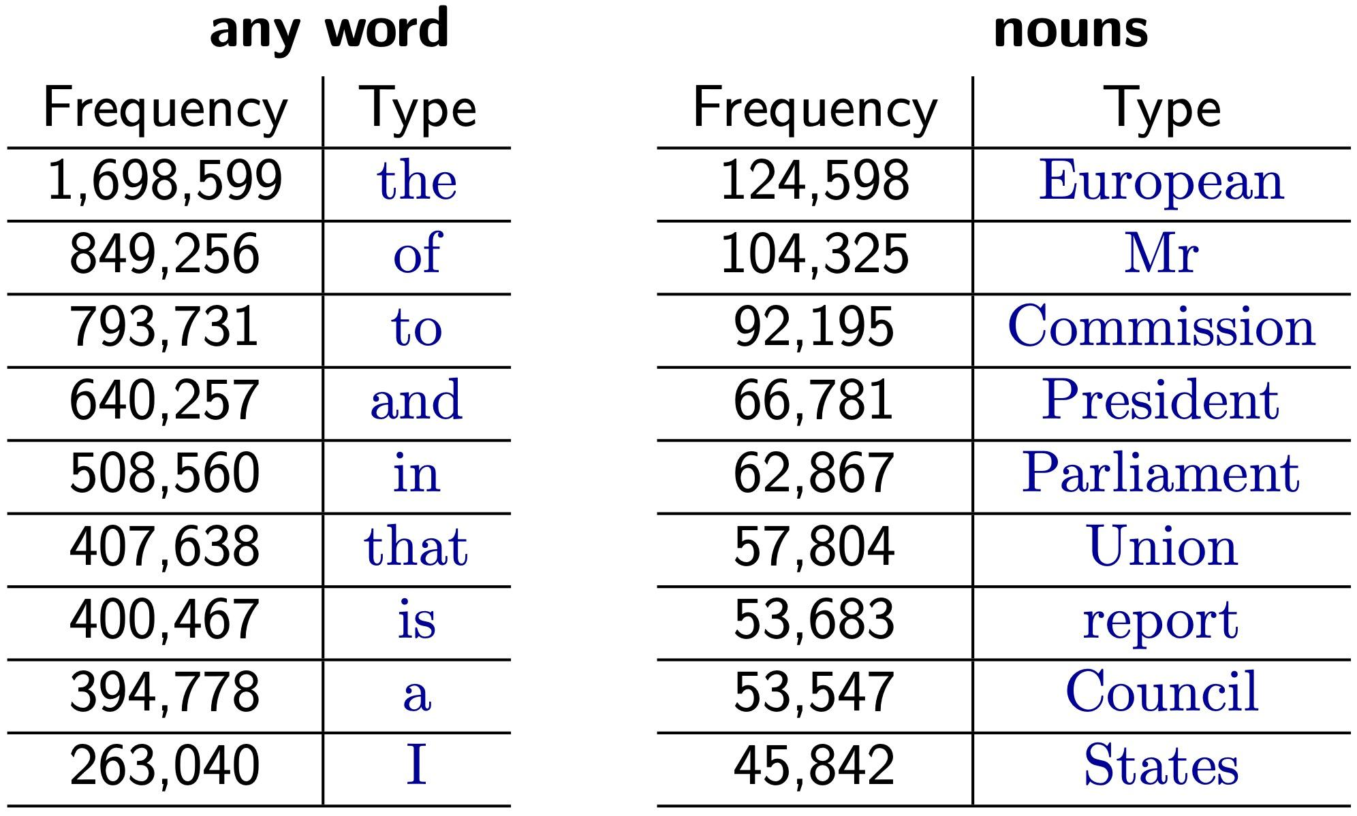
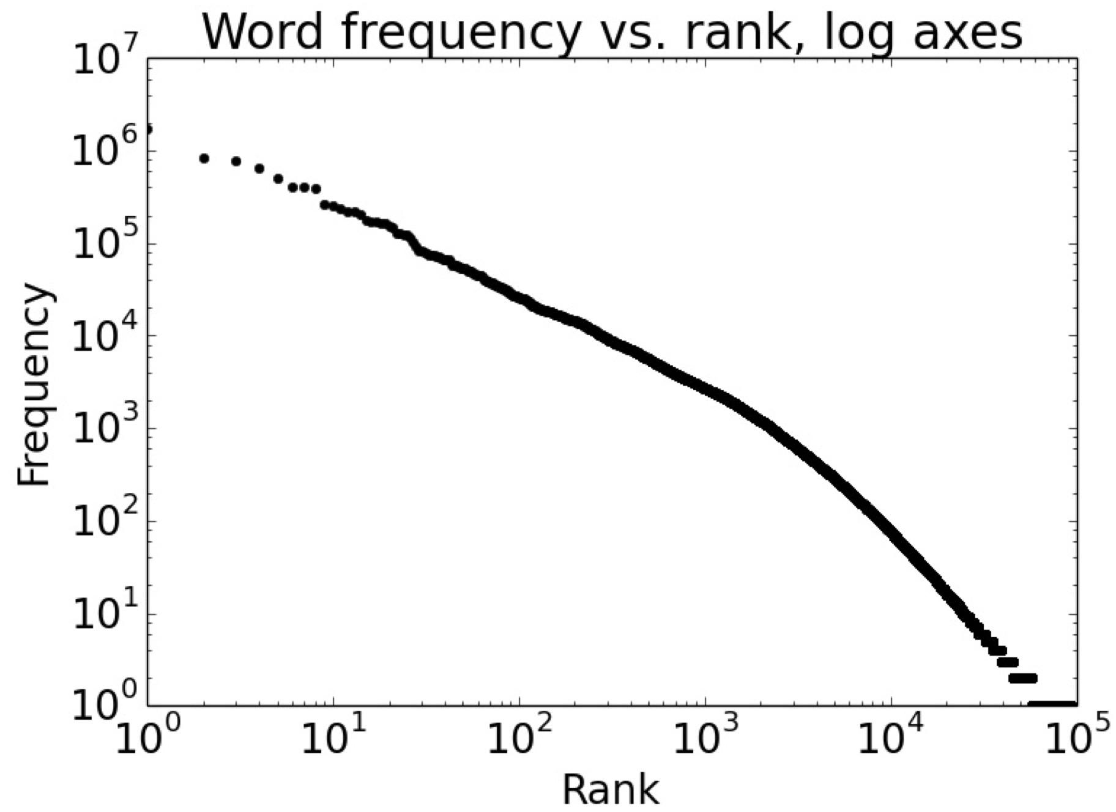
Sparsity
Zipf’s law: rank-frequency is inversely related.
Even if we collect large data, there exist many infrequent words.
Table and plot from Edinburgh NLP slide.

Slide 25
Variation
Mr. Vinken is chairman of Elsevier N.V., the Dutch publishing group.
An example from PTB.
Imao …, s/o to the cool ass asian officer 4 #1 not runnin my license and #2 not taking dru boo to jail. Thank u God. #amen
Many variations when conveying information by language.
Different styles, e.g., news and SNS.
Paraphrases.
Metaphor.
(Gimpel et al., 2011)
She gave the book to John.
I’m feeling blue.
She gave John the book.
I’m sad.

Slide 26



Knowledge
The elephant wears my pajamas.
The rat wears my pajamas.
The correct analysis highly dependents on contexts.
What World knowledge do we need to assume?
NLP is hard = AI is hard
<
<
Images from Unsplash.

Slide 27
What are methods for NLP?
Rule-based Methods
Corpus-based Methods
Probabilistic Models
Algorithm
Deep Learning

Slide 28
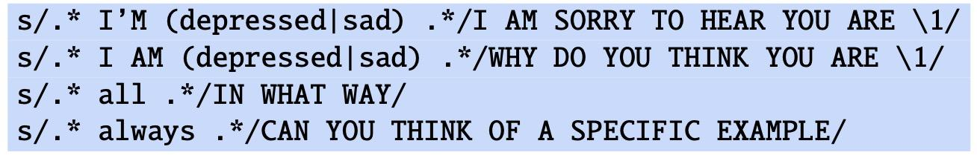
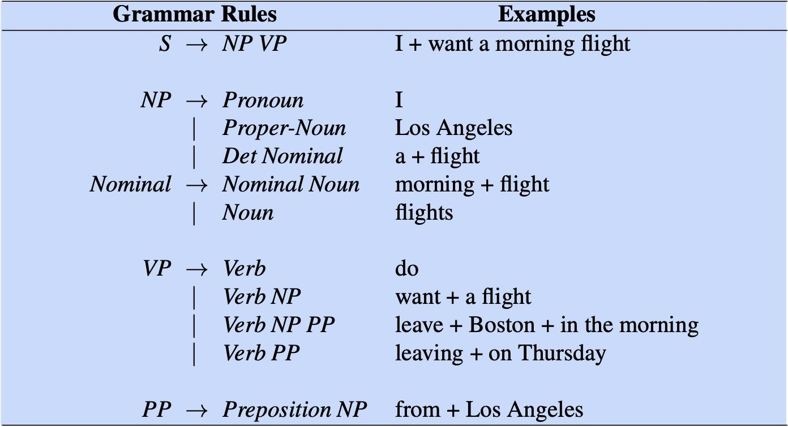
Rule-based Methods
An example from Chap. 2 of SLP
Finite state automata/transducers, i.e., regular grammar, and parsing/tree transducers, i.e., context free grammar.
Close relation with formal language theory.
An example from Chap. 12 of SLP

Slide 29
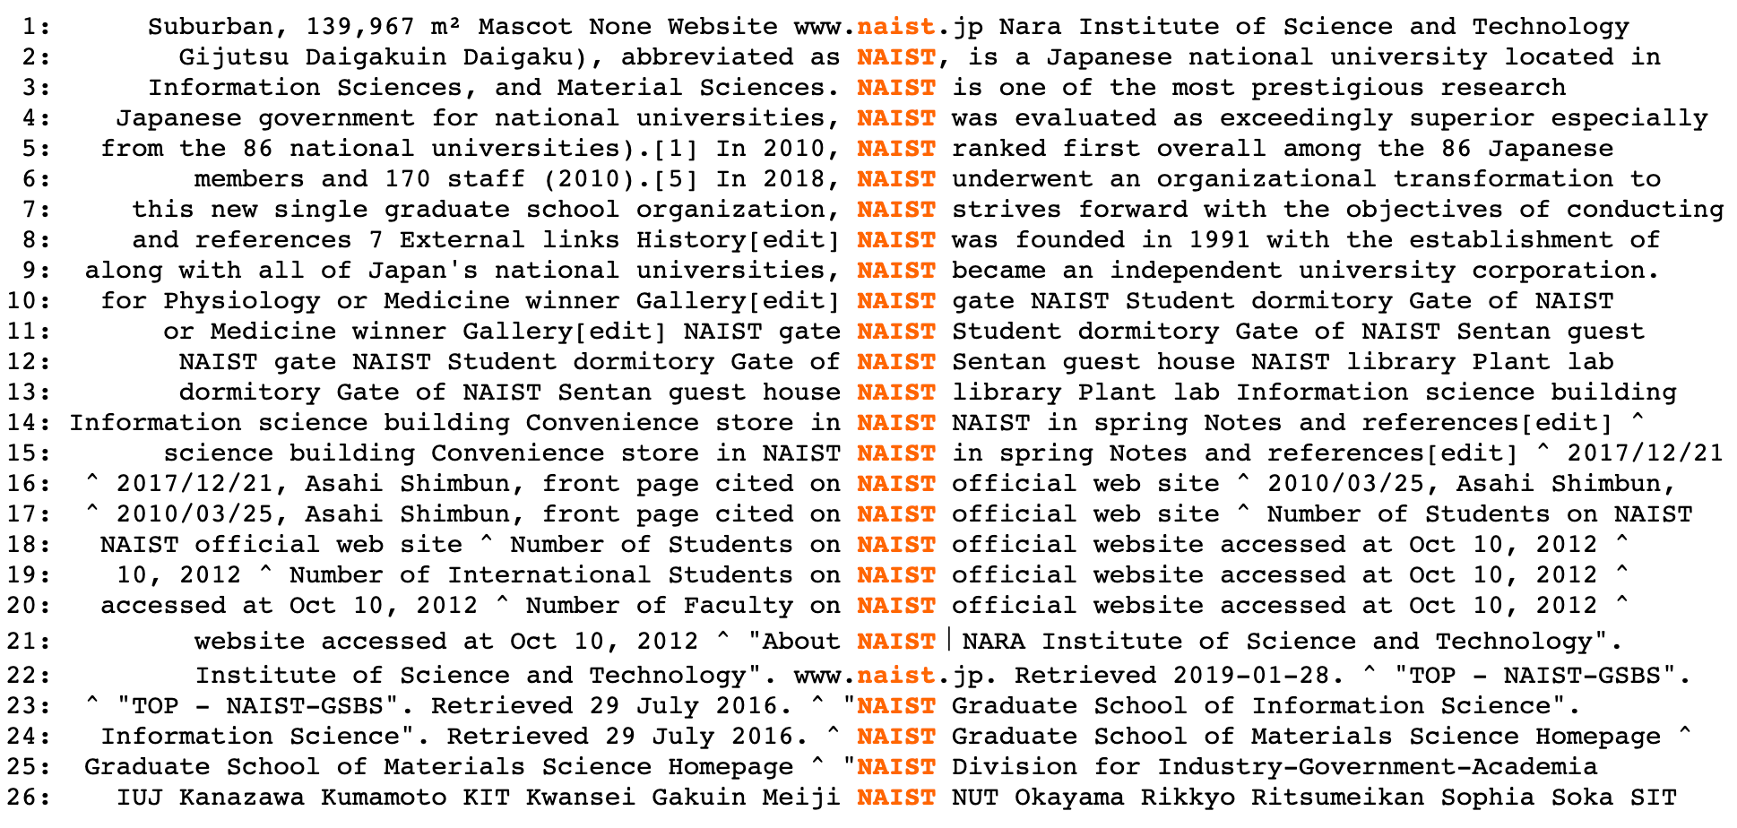
Corpus-based Methods
Exploit corpora to obtain linguistic representations.
Collect statistics on how a word appear in context.
Empirically verify your hypothesis.
webcorp live

Slide 30
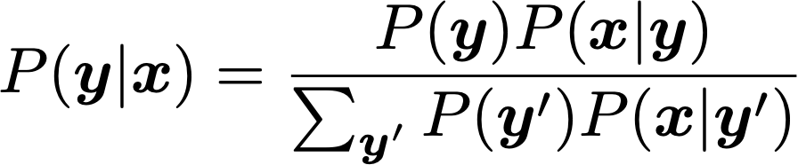
Probabilistic Models
Collect statistics on a corpus and estimate model parameters.
Naive Bayes, Logistic regression, HMM, CRF, Noisy channel, etc.

Slide 31
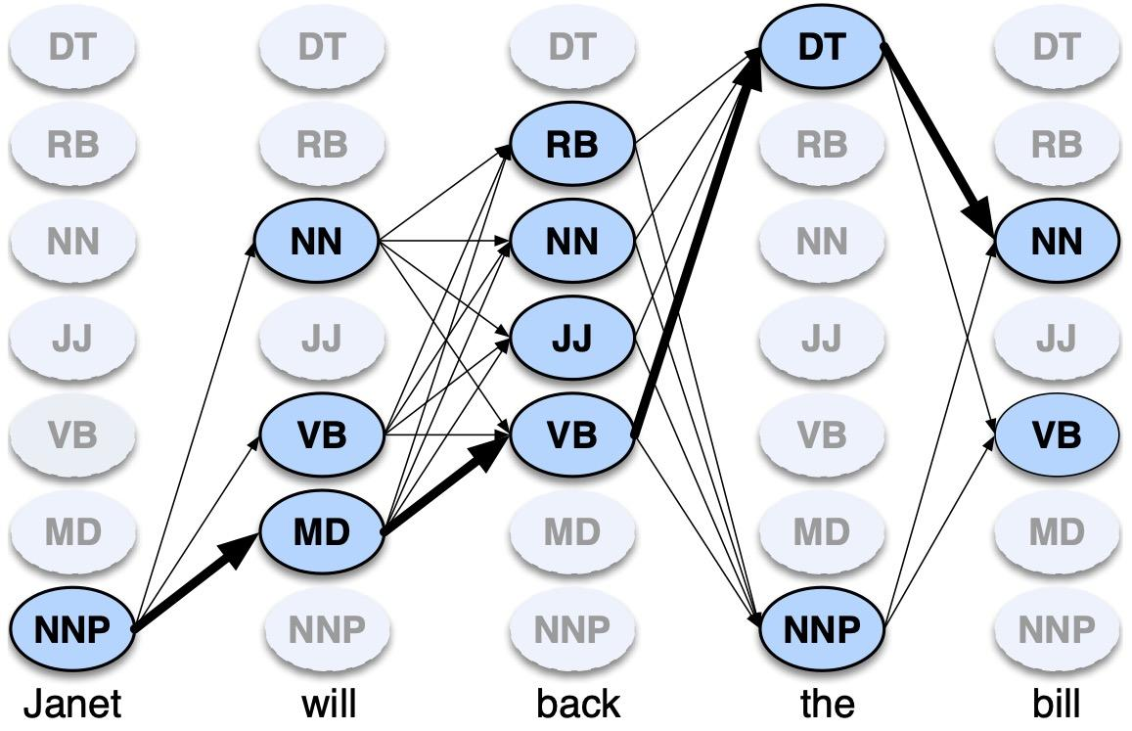
Algorithm
Dynamic Programming for efficient computation.
Viterbi algorithm, Forward-backward algorithm, Beam search, etc.
An example from Chap. 8 of SLP

Slide 32
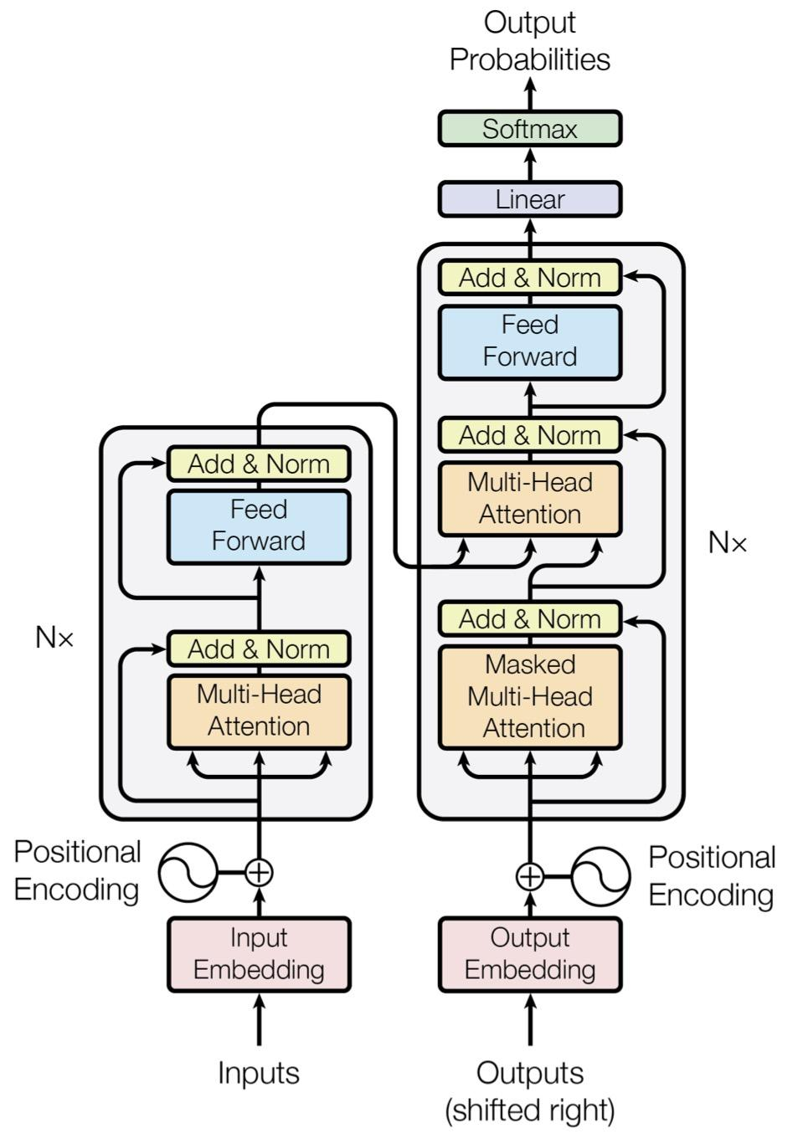
Deep Learning
Automatically learns feature representations.
Neural networks (NNs), feed-forward network, recurrent NN, convolutional NN, etc.
(Vaswani et al., 2017)

Slide 33
Why does NLP need data/corpus?
Too many success stories by machine learning, in particular, deep learning 😁
Empirical analysis on actual data, i.e., corpus, leads to new finings.
Data, e.g., test data, is also used to verify your hypotheses.
In machine learning/deep learning, data is used to build a model.
Supervised and unsupervised learning
Recently, pre-trained models have been used in many tasks.

Slide 34
Corpus
Pierre Vinken , 61 years old , will join the board as a nonexecutive director Nov. 29 .
Mr. Vinken is chairman of Elsevier N.V. , the Dutch publishing group .
Rudolph Agnew , 55 years old and former chairman of Consolidated Gold Fields PLC , was named *-1 a nonexecutive director of this British industrial conglomerate .
A collection of text with optional annotation, i.e., labeled and unlabeled data.
Texts are used to analyze languages.
Annotations are done either manually or automatically.
(ROOT (S (NP-SBJ (NP (NNP Pierre) (NNP Vinken)) (, ,) (ADJP (NP (CD 61) (NNS years)) (JJ old)) (, ,)) (VP (MD will) (VP (VB join) (NP (DT the) (NN board)) (PP-CLR (IN as) (NP (DT a) (JJ nonexecutive) (NN director))) (NP-TMP (NNP Nov.) (CD 29)))) (. .)))
(ROOT (S (NP-SBJ (NNP Mr.) (NNP Vinken)) (VP (VBZ is) (NP-PRD (NP (NN chairman)) (PP (IN of) (NP (NP (NNP Elsevier) (NNP N.V.)) (, ,) (NP (DT the) (NNP Dutch) (VBG publishing) (NN group)))))) (. .)))
Examples from Penntreebank-3

Slide 35
Supervised Learning
Training data
Tim Cook is the CEO of Apple.
PERS
ORG
Sundar Pichai is the CEO of Google.
A model learns to predict a label, e.g., annotation, given an input, e.g., text, from a training data.
Named entity recognition: given an input text, predict spans for entities.
PERS
ORG
Supervised learning
Input
Prediction
PERS
Steve Ballmer was the CEO of Microsoft.
Steve Ballmer was the CEO of Microsoft.
Model
ORG

Slide 36
Unsupervised Learning
The development of Shanghai's Pudong is in step with the establishment of its legal system
Xinhua News Agency, Shanghai, February 10, by wire (reporters Jinhu Xie and Chijian Zhang)
In recent years Shanghai's Pudong has promulgated and implemented 71 regulatory documents relating to areas such as economics, trade, construction, planning, science and technology, culture and education, etc., ensuring the orderly advancement of Pudong's development.
Pudong's development and opening up is a century-spanning undertaking for vigorously promoting Shanghai and constructing a modern economic, trade, and financial center. Because of this, new situations and new questions that have not been encountered before are emerging in great numbers.
In response to this, Pudong is not simply adopting an approach of "work for a short time and then draw up laws and regulations only after waiting until experience has been accumulated." Instead, Pudong is taking advantage of the lessons from experience of developed countries and special regions such as Shenzhen by hiring appropriate domestic and foreign specialists and scholars, by actively and promptly formulating and issuing regulatory documents, and by ensuring that these economic activities are incorporated into the sphere of influence of the legal system as soon as they appear.
A model induces latent information given an input and label pair.
MT: Induces word-wise alignment for a source-target sentence pair.
上海浦东开发与法制建设同步
新华社上海二月十日电（记者谢金虎、张持坚）
上海浦东近年来颁布实行了涉及经济、贸易、建设、规划、科技、文教等领域的七十一件法规性文件，确保了浦东开发的有序进行。
浦东开发开放是一项振兴上海，建设现代化经济、贸易、金融中心的跨世纪工程，因此大量出现的是以前不曾遇到过的新情况、新问题。
对此，浦东不是简单的采取“干一段时间，等积累了经验以后再制定法规条例”的做法，而是借鉴发达国家和深圳等特区的经验教训，聘请国内外有关专家学者，积极、及时地制定和推出法规性文件，使这些经济活动一出现就被纳入法制轨道。
Examples from English Chinese Translation Treebank

Slide 37
Pre-trained Models
Training Data
Google is an American multinational technology company focusing on search engine technology, online advertising, cloud computing, …
Tuning Data
Tim Cook is the CEO of Apple.
PERS
Learns a large model on huge data, then, fine-tune for a target task.
Pre-trained models predict a word given a context.
Transfer the learned representation for other prediction tasks.
ORG
Pre-trained Model
Fine-tuning
Input
Prediction
PERS
Steve Ballmer was the CEO of Microsoft.
Steve Ballmer was the CEO of Microsoft.
Model
ORG

Slide 38
How is NLP related to CL?
Engineering contribution
Natural Language Processing, NLP (= Artificial Intelligence)
Primary focus is the technology of processing language.
How to process, what could be done and how to improve the qualities of process.
Computational Linguistics, CL (= Cognitive Science)
Primary focus is the use of technology for linguistics.
How it works, what it is and why it is.
Scientific contribution

Slide 39
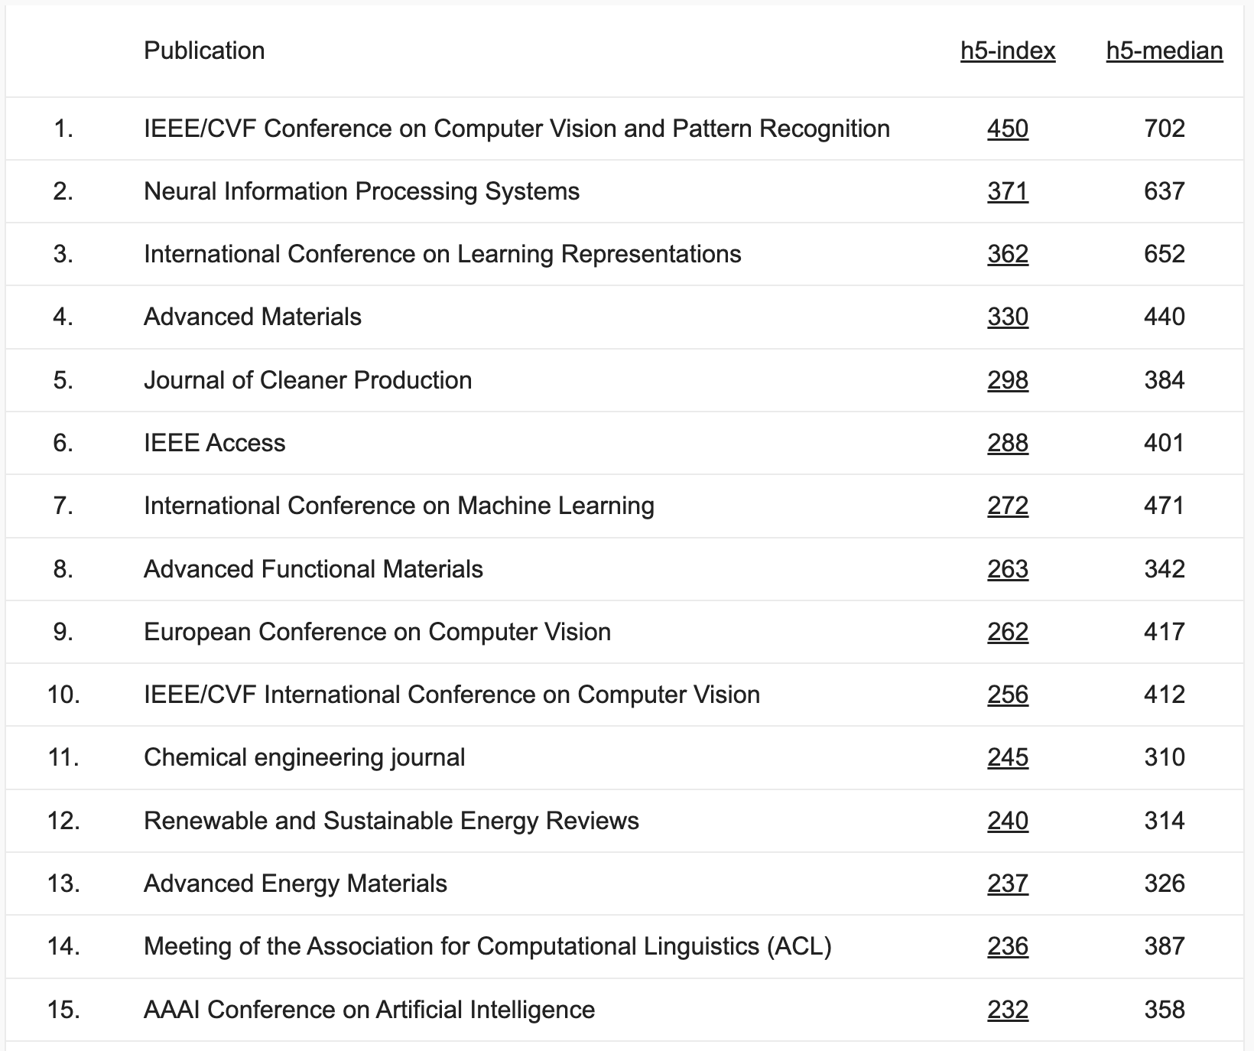
Venues
Rank 14th in Engineering & Computer Science by Google Scholar.
Machine learning & AI conferences are also related.
Recently, intersection with vision is important.
https://scholar.google.com/citations?view_op=top_venues&vq=eng

Slide 40
Brief History of NLP
Automata
information theory
MT: Georgetown-IBM
Corpus-based methods
Deep learning
Machine learning
ALPAC report
linguistics: syntax
Richer statical models
You!
1950
1960
1980
1990
2000
2013
2025

Slide 41
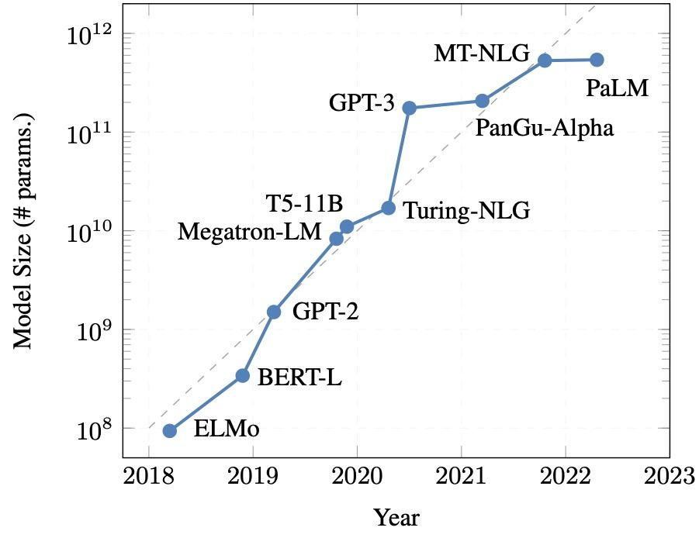
Scale
Scale is one of the key factors to the evaluation of NLP.
Generalization to various task with the growth of capacities (Kojima et al., 2022).
(Treviso et al., 2022)

Slide 42
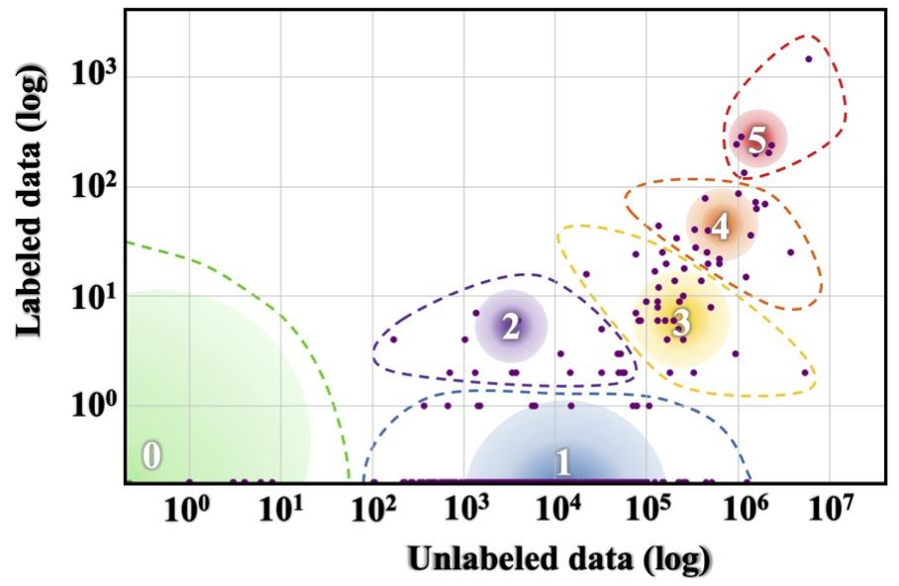
Language Diversity
Only a fraction of the 7,100+ living languages is focused.
Not sure whether a method works for diverse languages or not (Joshi et al., 2020).
(Joshi et al., 2020)

Slide 43
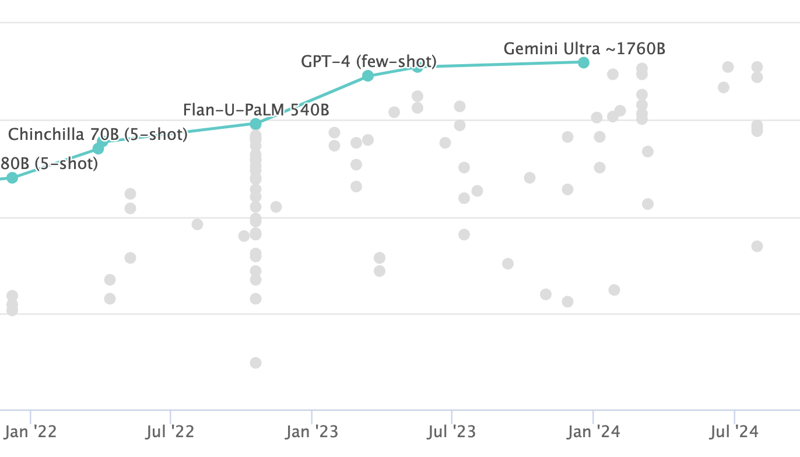
Improvements
Surpassing human experts (89.8%) by Gemini Ultra.
MMLU (Hendrycks et al., 2021) covering 57 tasks, e.g., mathematics, history, law etc.
https://paperswithcode.com/sota/multi-task-language-understanding-on-mmlu

Slide 44
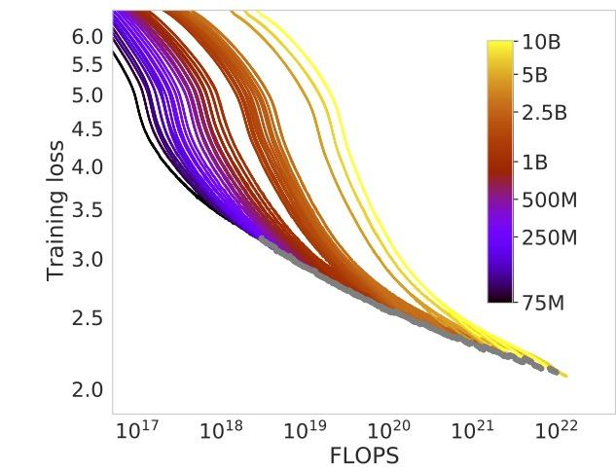
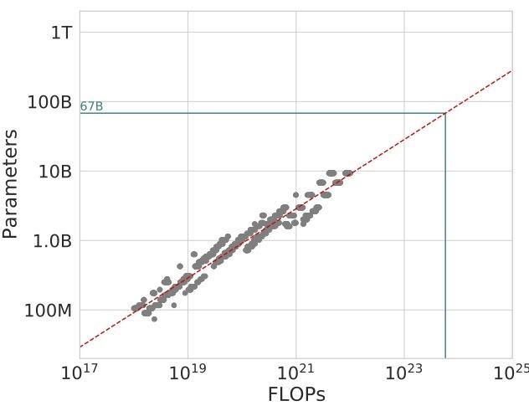
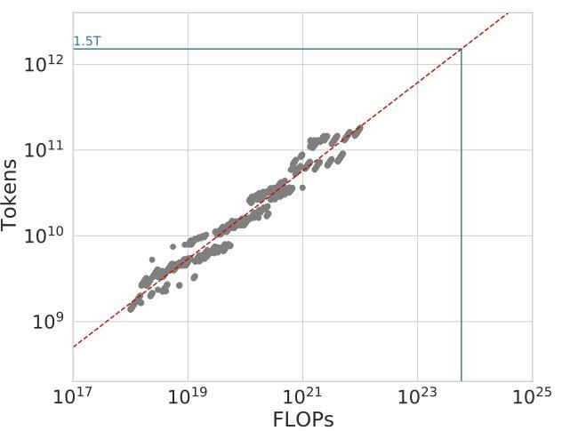
Efficiency
Compute and performance
Compute and data
Relation of model performance, the number of parameters and data scale.
Bigger the better!
We need large resources: Llama 3 70B (6.4M GPU)
How to improve the efficiency?
Compute and parameters
https://arxiv.org/abs/2203.15556

Slide 45
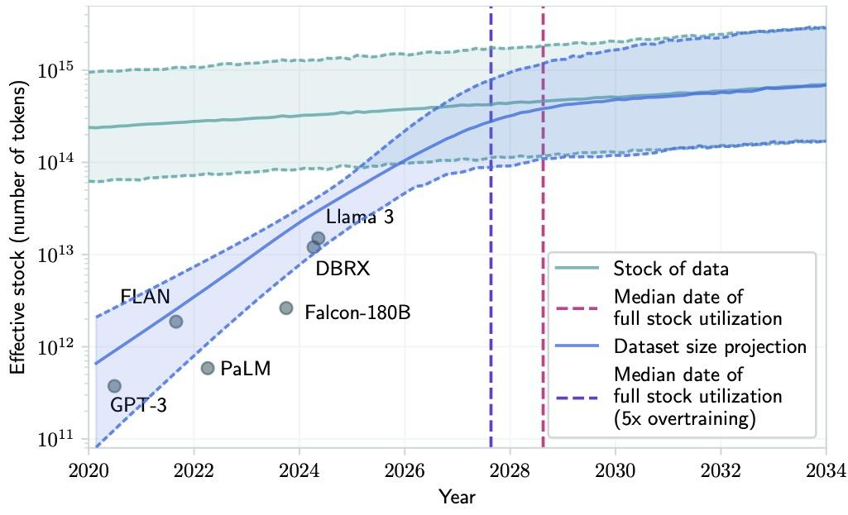
Data Outage
We are running out of training data.
Quantity to quality?
Exploit AI generated data?
Transfer from different modalities?
https://arxiv.org/abs/2211.04325

Slide 46
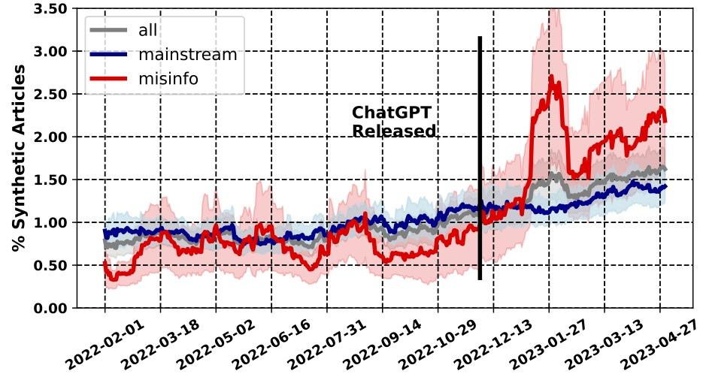
Data proliferation
Spread of artificially created articles after ChatGPT.
50% are created by AI (Hanley and Durumeric, 2024)
It is hard to differentiate them (Puccetti et al., 2024)
https://ojs.aaai.org/index.php/ICWSM/article/view/31333

Slide 47
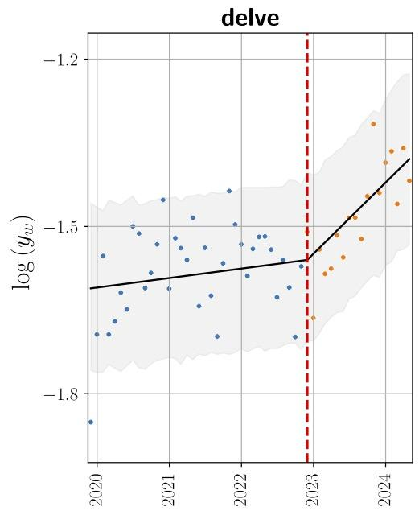
Impact to human languages
ChatGPT has an impact to how human use languages.
YouTube data clearly shows “delve” appearing after the launch (Yakura et al., 2024).
Impact to appearing or disappearing expressions.
https://arxiv.org/abs/2409.01754

Slide 48
Questions?

Slide 49
Logistics

Slide 50
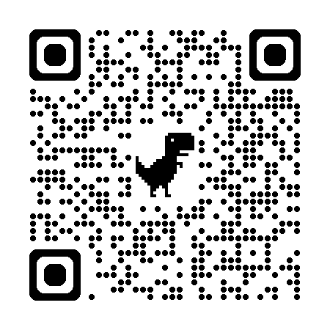
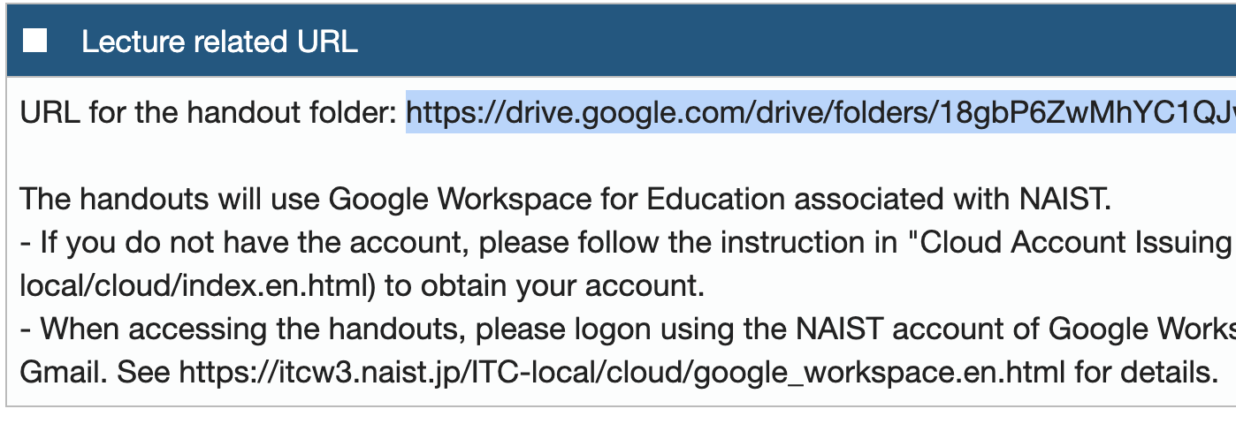
Find the folder for slides
Find the handouts from the Google Drive folder.
Check Lecture Related URL to find the information.

Slide 51
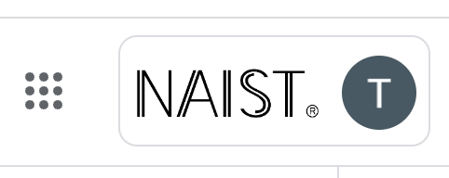
Important!
To access the slides, use Google Workspace issued by NAIST.
https://itcw3.naist.jp/ITC-local/cloud/google_workspace.en.html
Sign in using your Google Workspace account, i.e., {your account name}@g.ext.naist.jp.
Access https://drive.google.com to see if you sign in to the correct account by checking the “NAIST” logo.
If not successful, please ask our TA for help: pussewala.ashmari.ow4 @ naist.ac.jp

Slide 52
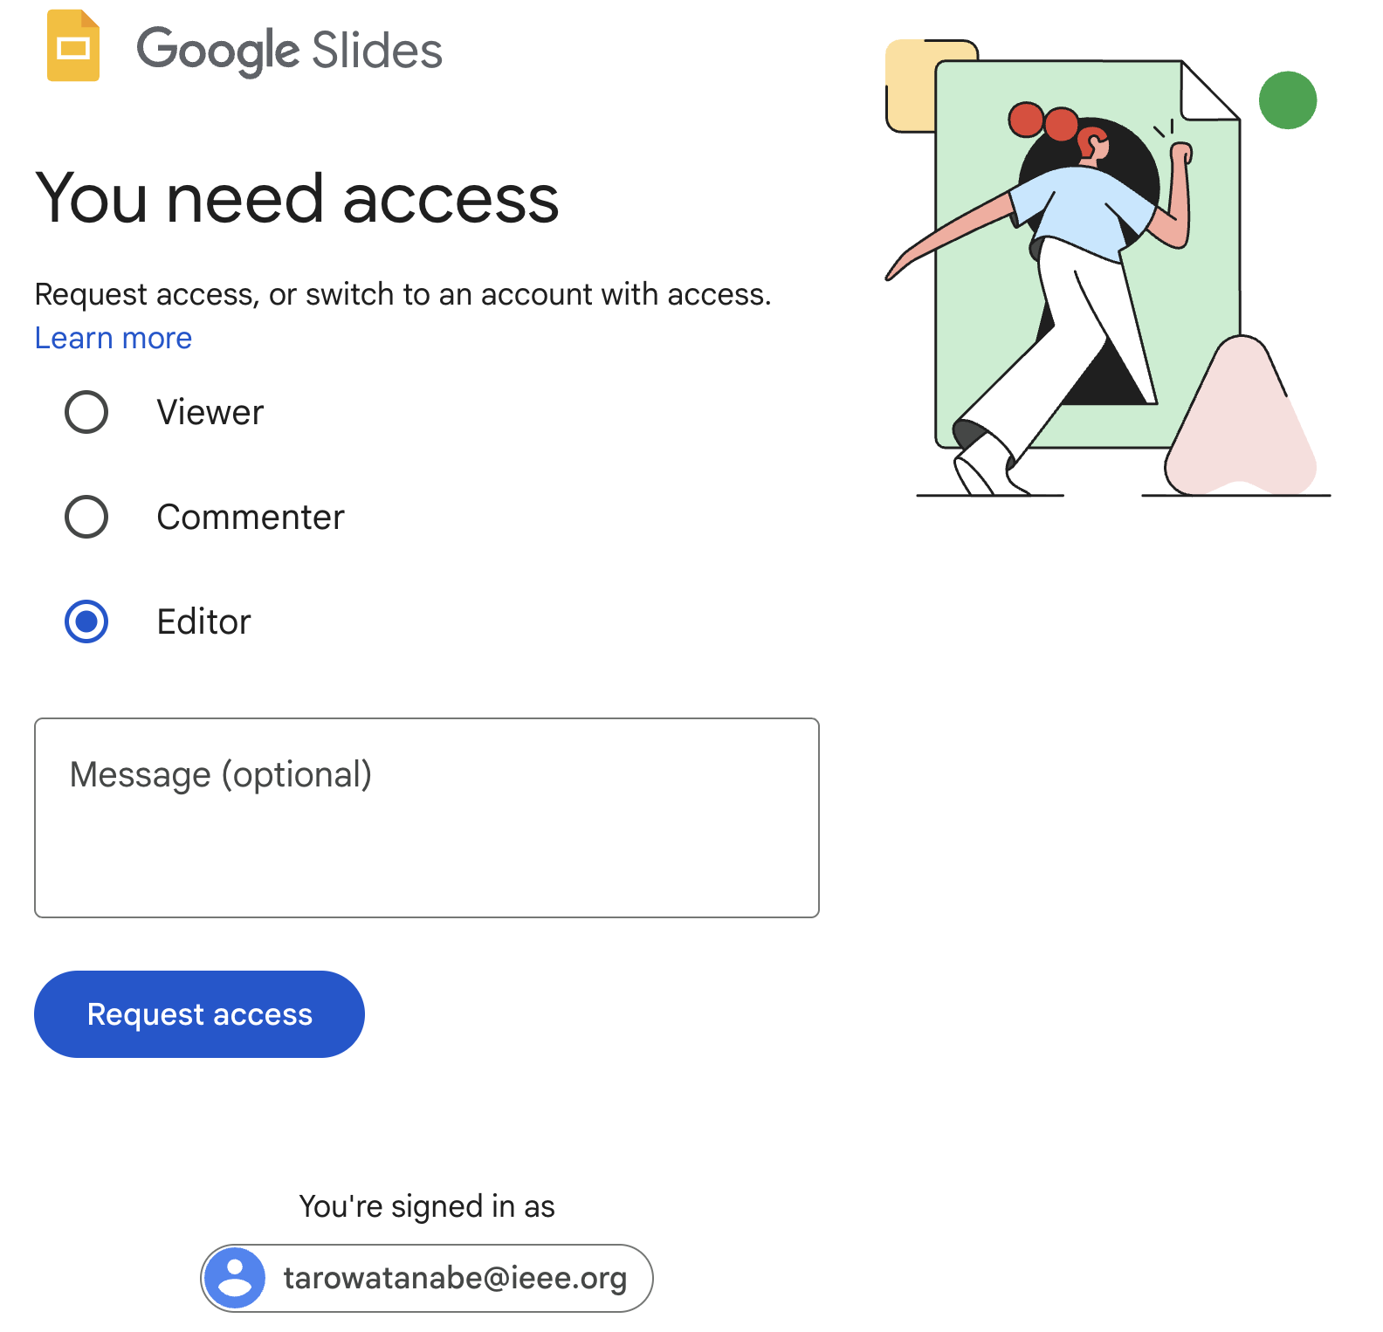
Request Access?
I’ll never grant your access for non-NAIST accounts, e.g., gmail.
Do not request access, but switch your account by clicking the email.
Sign-in using {your account name} @g.ext.naist.jp.
Click this email. If confused, ask our TA for help: pussewala.ashmari.ow4 @ naist.ac.jp

Slide 53
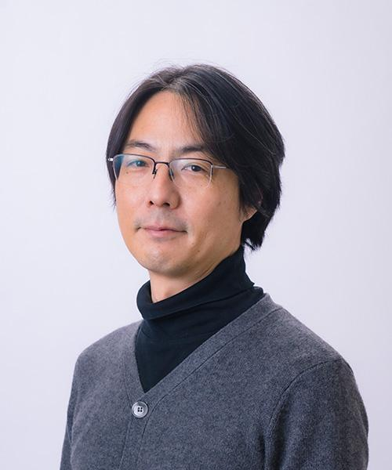
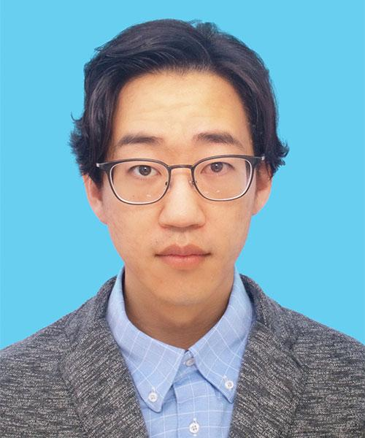
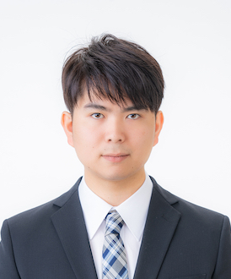
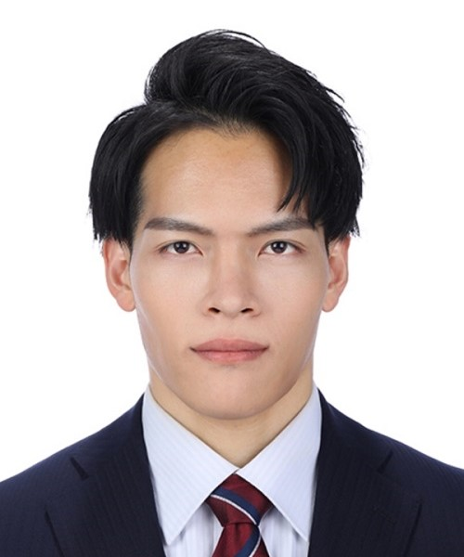
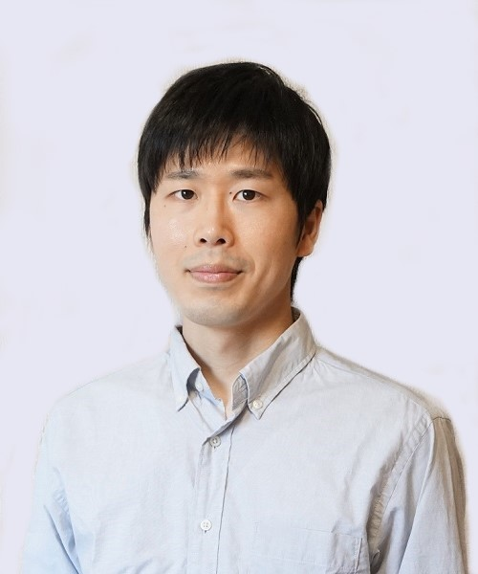
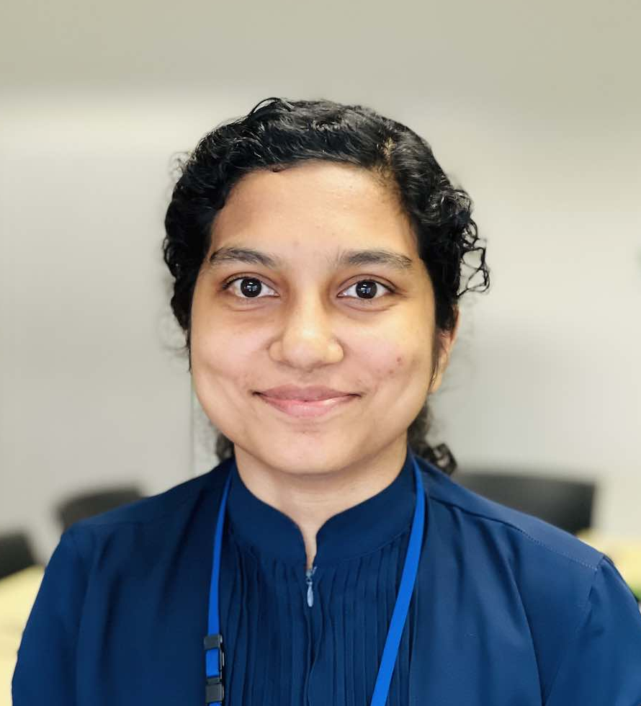
Lecturers and Teaching Assistant
Taro Watanabe
Hidetaka Kamigaito
Yusuke Sakai
Hiroki Teranishi
Shohei Higashiyama
TA: Ashmari Pramodya Pussewala Kankanange
Email: pussewala.ashmari.ow4 @ naist.ac.jp

Slide 54
Schedule
11/5 | Taro Watanabe | Basics about NLP
11/12 | Shohei Higashiyama | Word Segmentation and POS
11/19 | Taro Watanabe | Language Modeling
12/3 | Hidetaka Kamigaito | Conditional Language Modeling
12/10 | Hidetaka Kamigaito | Machine Learning
12/17 | Hiroki Teranishi | Syntactic and Semantic Parsing
12/24 | Yusuke Sakai | Information Extraction and Knowledge Graph
1/7 | Yusuke Sakai | Large Language Models

Slide 55
Lecture
You have a choice of onsite or archive.

Slide 56
Office Hours
On request: Please directly contact lecturers.

Slide 57
Assessment
Assessment is based on homework assignments.
Every lecturer will assign one report.
We will simply take an average of scores from all the reports. Thus, don’t miss any of them.
You should submit your own work.
Any external resources, e.g., books, papers, web pages, chat apps or your colleagues, must be cited and acknowledged appropriately.

Slide 58
Report Submission
Submit your reports through https://edu-portal.naist.jp/.
Submit your report in PDF using Word, Overleaf etc, or a tool specified by the lecturer in each assignment. No handwritings.
Late submission policy after deadline:
We will accept late submission within 3 weeks. Submit your report using the group marked by Late Submission.
Scores will be scaled: 50% when submitted within 1 week, 25% within 2 weeks and 12.5% within 3 weeks.

Slide 59
Optional Readings
Readings are optional.
Last Words: Computational Linguistics and Deep Learning (Manning 2015)
Boring Problems are Sometimes the Most Interesting (Sproat 2022)
Oh, yes, everything’s right on schedule, Fred (Brown and Mercer 2013)

Slide 60
(Again) Questions?

